Slide 1
Probe Data Analysis for Road Slope
Kunal Dhande
A20369862
Kunal Kolhatkar
A20373885

Slide 2
oVERVIEW
What is Probe Data ?
It is data which is generated by monitoring the position of moving objects over space and time. These moving objects can be dedicated vehicles used to collect information.
The individual probe points consist of ProbeID, dateTime, sourceCode, latitude, longitude, altitude, speed, heading etc.
What is Link Data?
The link data is information of road segments (links). It consist of data for the links that probe points can be map-matched to.
It consist of linkPVID, length, directionOfTravel etc

Slide 3
Task
1.In this assignment we have to map-match probe points to road links.
2.Then as an application of Probe Data we derive road slope for each road link.
3. Finally we evaluate derived road slope with surveyed road slope present in the link data file.

Slide 4
APPROACH
1.Map-Matching
Latitude and Longitude are given in both Probe Data and Link Data.
To Map- Match we use these Latitude and Longitude information of both these files and compare them with every other to find the one-pair with minimum distance between them.
This pair is resultant Map-Matched Probe data points to corresponding Link.

Slide 5
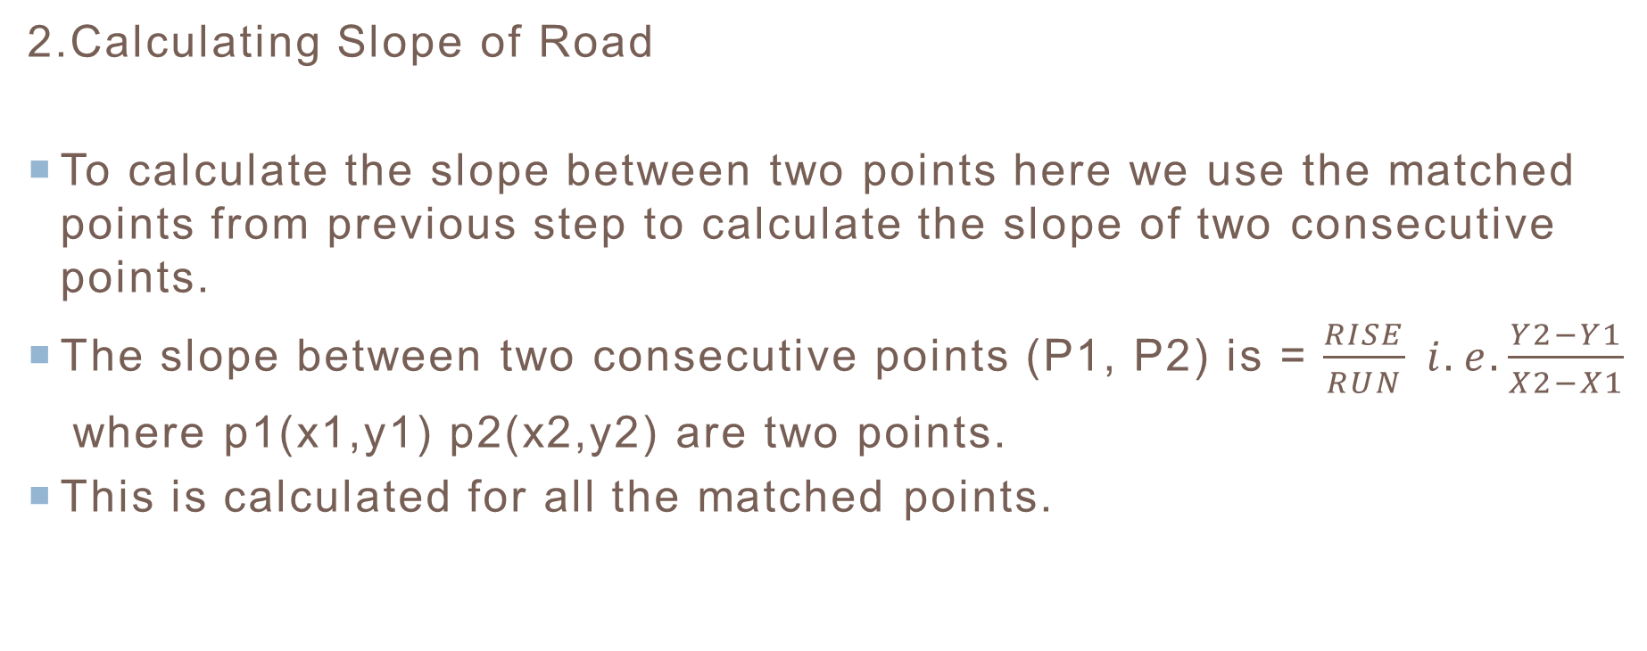
APPROACH continued..
2.Calculating Slope of Road
To calculate the slope between two points here we use the matched points from previous step to calculate the slope of two consecutive points.
The slope between two consecutive points (P1, P2) is = $\frac{RISE}{RUN} i.e. \frac{Y2−Y1}{X2−X1}$
where p1(x1,y1) p2(x2,y2) are two points.
This is calculated for all the matched points.

Slide 6
APPROACH continued..
3. Evaluating derived road slope with surveyed road slope
Average of slope is calculated for each Link data.
This slope is then compared with the slope we calculated in previous step.

Slide 7
Result
The source code is present in two different folder with Instructions to run the program in ReadMe file.
The Resultant files containing evaluation results are present in folder.

Slide 8
references
Guest lecture notes by Dr. Bo Xu
“Online map-matching based on Hidden Markov model for real-time traffic sensing applications” by C.Y. Goh, J. Dauwels, N. Mitrovic, M. T. Asif, A. Oran, P. Jaillet (2012 ITSC)
“Map-Matching for Low-Sampling-Rate GPS Trajectories” Yu Zheng, MS Research

